Slide 1
SCM Process, Repository and Tools

Slide 2
SCM Process
A process defines the steps by which you perform a specific task or set of tasks.
An SCM process is the way SCM is performed on your project specifically, how an SCM tool is applied to accomplish a set of tasks.
A key mistake most people make is to assume that an SCM tool will, in and of itself, solve their SCM problems or support their SCM requirements.
How you apply the SCM tool to your development environment is called the usage model, or SCM process.
It is this model or process that will in part determine how successfully you address your SCM issues.

Slide 3
Unified Change Management
is a software-configuration management process for software
development that
spans the development life to requirements, design
cycle, models,
managing change
documentation, components, test cases, and source code
Fundamental to UCM is the unification of the activities used to plan and track project progress with the artifacts being changed
Implementation of the UCM model is realized by both process and tools

Slide 4
Unified Change Management
UCM was derived from observed best practices in thousands of development organizations that demonstrated a capability to develop software in a robust, scalable, and repeatable way.
By automating these best practices, UCM provides value to a development organization in many ways, but four areas are key:
Abstraction: work best on higher-level tasks
Communication: about individual activities, relieving developers of the burden of remembering the specific files and versions they created to fulfill activities on which they worked

Slide 5
Unified Change Management
Stability: the project progresses in a known, controlled way with markers placed along the way to denote intermediate stable points
Control: mechanisms to assist in managing the flow of changes from a developer's isolated development stream to a project-integration area or to other developers; tracking, managing, and controlling the flow of changes from the project's integration area or from other developer's streams; and assisting in integrating those changes

Slide 6
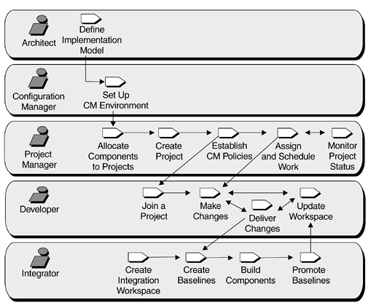
UCM Process Overview

Slide 7
A new role…
The configuration manager is familiar with an organization's configuration and change-management processes and with the SCM tools being used.
The configuration manager is responsible for creating and maintaining the physical infrastructure necessary to implement the design.
This primarily involves creating and maintaining repositories and importing existing files and directories.
(In some organizations the configuration manager is also responsible for things such as disk space allocation, network resources, and backup strategies as they relate to SCM data.
The process described here allocates these activities to the system administrator.)

Slide 8
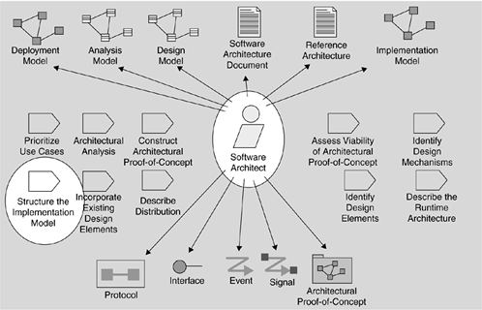
The Architect: Defining the Implementation Model

Slide 9
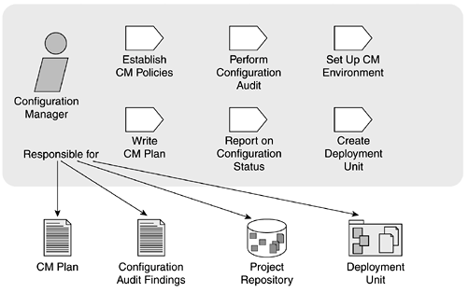
The Configuration Manager: Setting Up the SCM Environment

Slide 10
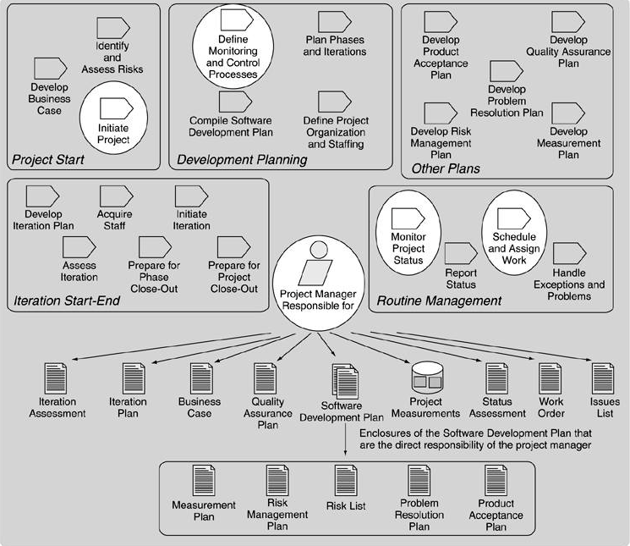
The Project Manager: Managing a Project

Slide 11
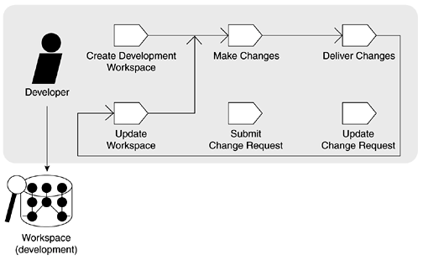
The Developer: Joining a Project and Doing Development

Slide 12
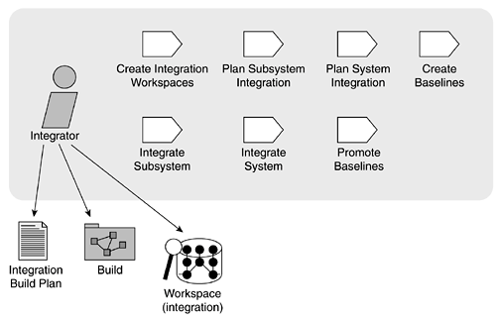
The Integrator: Integration, Build, and Release

Slide 13
Tools

Slide 14
SCM tools are software tools that automate and facilitate the application of the SCM best practices.
It is unrealistic to try to maintain effective SCM without an SCM tool.
The goal of successful SCM is to allow as much change as possible while still maintaining control of the software.
SCM tools help automate tedious, manual, and error-prone pieces of the SCM process, and can ensure that your project can support all of the SCM best practices.

Slide 15
SCM Tools Examples
Microsoft Visual Source Safe (VSS)
Concurrent version system (CVS)
Subversion (SVN)
ClearCase
SourceForge
Rational Team Connect (RTC)
Microsoft Team Foundation Server (TFS )
Bugzilla
Mantis
IBM Rational ClearCase
GIT

Slide 16
SCM Tools Examples (web–Collaborative )
GitHub
GoogleCode
Gforge
Jazz
Microsoft Team Foundation Server

Slide 17
Version Controlling tools:
SVN (Subversion), CVS
Project Compiling scripts and Automation:
ANT, NANT, VB Script, Cruise Control
Software Packaging:
NSIS – Nullsoft Scriptable Install System
Bug Tracking:
Mantis, Jeera

Slide 18
SCM Tools Basic Functions
To maintain a library or repository of files
To create and store multiple versions of files
To provide a mechanism for locking (to enforce serialized change to any given file)
To identify collections of file versions
To extract/retrieve versions of files from the repository

Slide 19
CM Tools - Necessary Features
Versioning
Dependency Tracking
Audit Trails
Reporting of Changes
Supports the Change Rules
Requirements Tracing
Repository arranged as "basic objects" and "aggregate objects"
Supports both Linear evolution and Trees

Slide 20
Repository

Slide 21
Is Set of mechanisms and data structures that allow
a team to manage change in an effective manner.
All items under configuration are placed into a repository
This repository is controlled by a tool like RCS or CVS
CM Repository-
Configuration Item
standard term for entities in the CMR
CM Objects
CM probably organized as object-oriented database
Basic Objects
Aggregate Objects

Slide 22
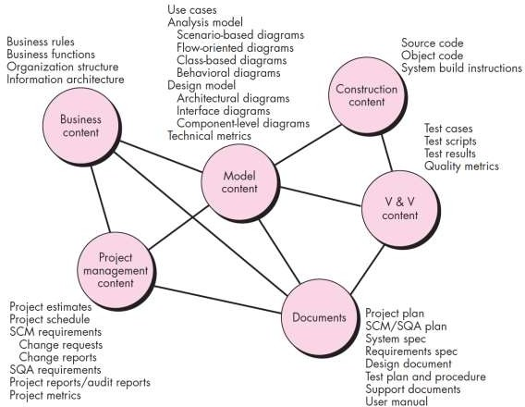
Contents of SCM Repository

Slide 23
Functions of a Repository
Access to repository is controlled by a security policy (in CVS/RCS a username/password)
After a user is logged into the repository they can:
Check-out a file for use
Check-in a changed file back into the repository
Tag the repository at a certain date/time
Place a new file into the repository

Slide 24
File Check-Out
Check-out:
The repository marks the file as checked-out
In concurrent systems (like CVS), a list of all users that have checked out the file is maintained
In locking systems (like RCS), only one user can check-out a file at a time. In essence the file is locked for future use
CVS can work in both locking and concurrent modes

Slide 25
File Check-In…
Check-in:
The file is modified and the changed version is checked back into the repository
If the file was locked – then only the user that checked it out can unlock it by checking in the same file (verified on file name only)
In a concurrent system – the first user to check in will cause the system to enter a conflict resolution mode

Slide 26
File Check-In…
In a concurrent versioning system:
Users can potentially work on the same file at the same time
If two users change the same sections of the file then when checking in, the system will flag a merge conflict
Merge conflicts have to be resolved before the file can be placed into the repository
This allows more flexibility, however it can be more dangerous as well when used without sufficient training

Slide 27
File Check-In
Most companies have procedures that will outline the steps to take before a file is checked back into the repository
All changes made to the file are documented in a “status log” during the check-in process
Some procedures require the change request number to be stated after a certain date

Slide 28
Tagging a Repository…
As software evolves the files that make up the system are all at different version levels
Example (from an O/S can be)
Text editor v3.0
Internet explorer v5.5
Kernel build 1885
Windowing system build 23
Etc…
Before the above configuration is released – we need to note down these numbers. That process is known as tagging the repository

Slide 29
Tagging a Repository
Once a repository is tagged
We can revert back to this level even if a large number of changes are made
The tag number can be issued to the quality and testing teams for verification.
Repository is tagged at regular intervals,
Weekly is typical early in the life cycle
Daily towards the end or if the process calls for high-frequency integration

Slide 30
Ensuring Build Consistency
When developers check-in source code with modifications – the changes may cause more bugs
To ensure that new changes do not cause unexpected failures many techniques are used by developers:
Regression testing
Compile & link verification
Static audits
Metrics trends
This aspect of development is one of the most important and requires careful monitoring

Slide 31
What is Regression Testing?
Simply put, it is repetition of existing tests
Usually done after minor changes are made to code
It does not apply for enhancements
Before checking in the changes into a repository
It can be seen as selective testing
Intention is to show that modifications have not caused unintended effects
Verifies that the system still complies with its specified requirements
Notes:
Regression testing is nothing more than repetition of existing tests.
These tests are run when we make minor changes to software or the environment where the software will have to exist.
During a normal development process, we develop classes and modules.
These classes are unit tested and we integrate them with all the other collaborating classes.
Then, we run an integration test suite on the complete system at the appropriate level.
Once integrated and tested to a suitable level of confidence, we go on and develop other parts of the system.
However, over time, some of the older classes need changes.
When these changes are made, we need to retest the entire system, or selectively test some parts of the class.
Essentially, this test is the same of the original test suite.
However, the intention here is to show that modifications made have not caused any unintended problems.
If the test suite is run constantly on the entire system as new modules are integrated, we can check that the entire system complies with the required specifications.

Slide 32
Regression Testing
Test Case
Verifies
Initial Version
(v3.2)
Reveals
Faults
Minor
Modifications
fixes
Verifies
Changed Version
Regression Testing
Notes:
This process of retesting again is called regression testing.
Let us look at some more terminology now to establish the regression testing concepts in more depth.

Slide 33
Regression Testing Limitations
Regression test suite does not contain tests for new or changed capabilities
When a primary test suite is promoted to become a regression test suite, it is no longer effective as a primary test suite
Once a version has passed all of its test cases, the test suite has revealed all the bugs that it can and must be changed to look for new changes
Notes:
NOTE: THIS SLIDE PRETTY MUCH SAYS THE SAME THING MANY WAYS – THIS IS INTENTIONAL
The information here is often ignored during development, so it is important to stress it again and again
Regression testing is a powerful technique to manage, change, and ensure the quality of software under development.
However, it can be limited.
If it is pushed beyond its scope, we will not get positive results.
Regression test suites do not contain tests for new or changed capabilities.
A regression test suite is a static promoted primary test suite.
We do not make any changes to a regression test suite, so it will not be able to test for new or changed capabilities.
When we have new or changed capabilities, an updated primary test suite must be used.
When the implementation passes this test suite, we can then promote it again to create a newer version of the regression test suite.
When a test suite is reused as a regression test suite, it is no longer effective as a primary test suite.
This is because regression test suites are not effective when checking new features.
New features should be tested using an updated primary test suite.
Once a baseline has passed all of its test cases, the baseline test suite has revealed all the bugs that it can.
It does not become effective until a change is made in the component or in another component in the same system.
This is an important point, because many organizations used the primary as a regression test suite.
When new features are added, they update the primary and rerun the test again.
This practice works well for small teams and small projects.
However, for any serious software development efforts, we need to promote the primary test suite regularly into a regression test suite.
This will also give us the ability to guarantee the separation between a current version in development, and the current version in test.

Slide 34
Compile and Link Verification
This process is applied mainly to source code before checking it into a repository
The changed copy is built locally on the developers workspace
The aim is to ensure that there are no compiler errors, warnings or link failures when integrated with the existing set of code as mirrored on the repository
This is the simplest form of check, and increases confidence – this does not check for bugs.

Slide 35
Static Audits
Applicable to source code
Before check-in the changed code is passed through a static code verification tool
Any violations or failure to meet company standards are picked up by this tool
All issues are resolved before check-in
This step can ensure that the overall quality of the code in the repository is higher
Does not detect functional bugs or errors that can be caused at runtime.

Slide 36
Metrics Trends
This step is another step to ensure that poor quality code does not enter the repository
Company can define a global standard on the size of methods, allowed complexity etc…
If changes have caused a deviation from the norm, then it required approval from the team leader before being checked into the repository
The code is analyzed over a period to ensure that over time the code does not deteriorate.

Slide 37
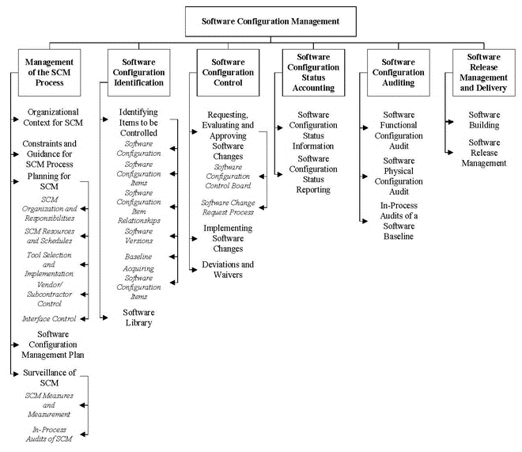
Finally

Slide 38
SCM is like an insurance policy.
Effective SCM can ensure:
Rework cost is reduced
Effort put into development is not wasted
There is no loss of control as software evolves

